Slide 1
CSC410 - Professional Practices in IT
Instructor Name : Sidra Nasir

Slide 2
Today Topics
Intellectual Property Rights
Protecting intellectual property
Fair Use

Slide 3
Chapter 4: Intellectual Property

Slide 4
Information Technology Changing Intellectual Property Landscape
Value of intellectual properties much greater than value of media
– Creating first copy is costly
– Duplicates cost almost nothing
Illegal copying pervasive
– Internet allows copies to spread quickly and widely
In light of advances in information technology, how should we treat intellectual property?

Slide 5
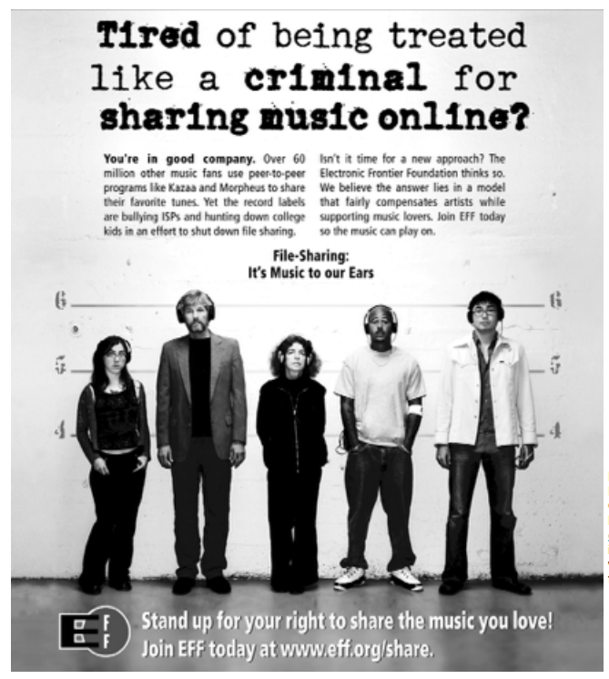
Reproduced by permission of Electronic Frontier Foundation via Creative Commons Attribution License 3.0. Go to www.eff.org/ copyright for redistribution information. To access the original work, go to w2.eff.org/IP/P2P/? f=music-to-our-ears.html

Slide 6
Intellectual Property Rights

Slide 7
What Is Intellectual Property?
Intellectual property: any unique product of the human intellect that has commercial value
– Books, songs, movies
– Paintings, drawings
– Inventions, chemical formulas, computer programs
Intellectual property ≠ physical manifestation
Does right to own property extend to intellectual property?

Slide 8
Property Rights
Locke: The Second Treatise of Government
People have a right…
– to property in their own person
– to their own labor
– to things which they remove from Nature through their labor
• As long as…
– nobody claims more property than they can use
– after someone removes something from common state, there is plenty left over

Slide 9
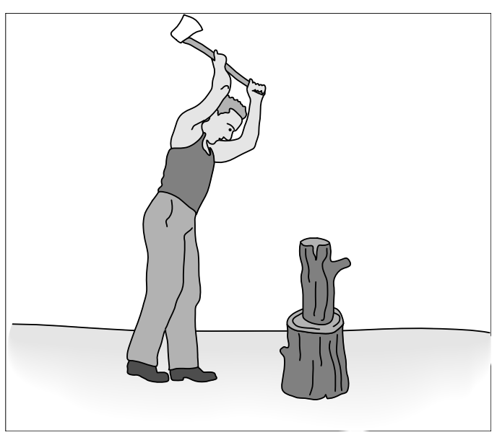
Locke’s Notion of Property Rights

Slide 10
Expanding the Argument to Intellectual Property
Writing a play akin to making a belt buckle
Belt buckle
– Mine ore
– Smelt it down
– Cast it
Writing a play
– “Mine” words from English language
– “Smelt” them into prose
– “Cast” them into a complete play

Slide 11
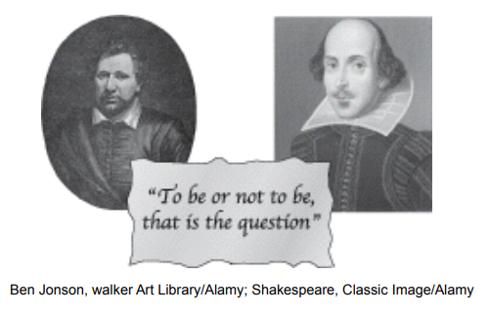
Analogy Is Imperfect

Slide 12
Analogy Is Imperfect
If Ben Jonson and William Shakespeare simultaneously write down Hamlet, who owns it?
If Ben “steals” the play from Will, both have it
These paradoxes weaken the argument for a natural right to intellectual property

Slide 13
Benefits of Intellectual Property Protection
Some people are altruistic; some are not
Allure of wealth can be an incentive for speculative work
Authors of U.S. Constitution recognized benefits to limited intellectual property protection

Slide 14
Limits to Intellectual Property Protection
Giving creators rights to their inventions stimulates creativity
Society benefits most when inventions in public domain
Congress has struck compromise by giving authors and inventors rights for a limited time

Slide 15
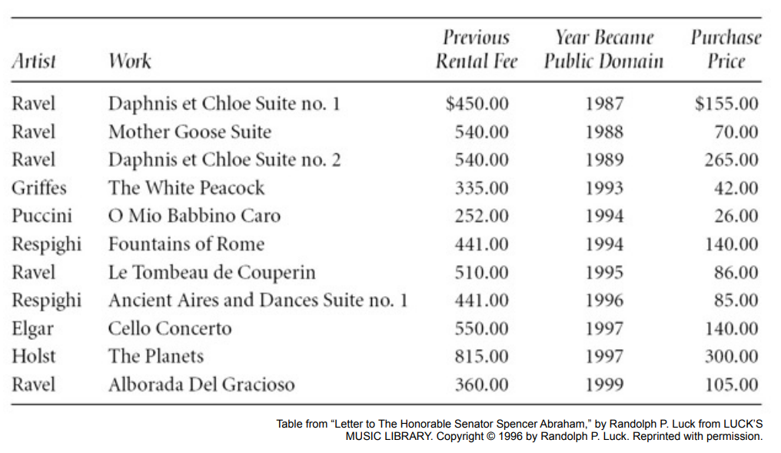
Prices Fall When Works Become Public Domain

Slide 16
Protecting Intellectual Property

Slide 17
Trade Secret
Confidential piece of intellectual property that gives company a competitive advantage
Never expires
Not appropriate for all intellectual properties
Reverse engineering allowed
May be compromised when employees leave firm

Slide 18
Trademark, Service Mark
Trademark: Identifies goods
Service mark: Identifies services
Company can establish a “brand name”
Does not expire
If brand name becomes common noun, trademark may be lost
Companies advertise to protect their trademarks
Companies also protect trademarks by contacting those who misuse them

Slide 19
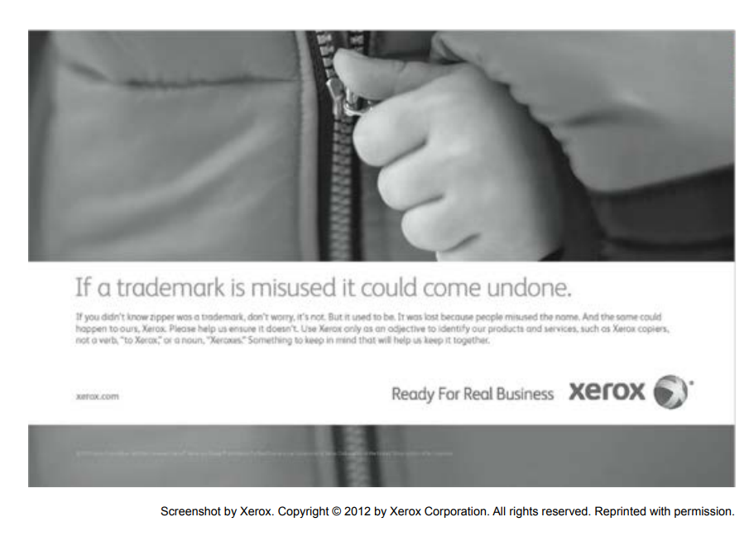

Slide 20
Patent
A public document that provides detailed description of invention
Provides owner with exclusive right to the invention
Owner can prevent others from making, using, or selling invention for 20 years

Slide 21
Copyright
Provides owner of an original work five rights
– Reproduction
– Distribution
– Public display
– Public performance
– Production of derivative works
• Copyright-related industries represent 6% of U.S. gross domestic product (>$900 billion/yr)
• Copyright protection has expanded greatly since 1790

Slide 22
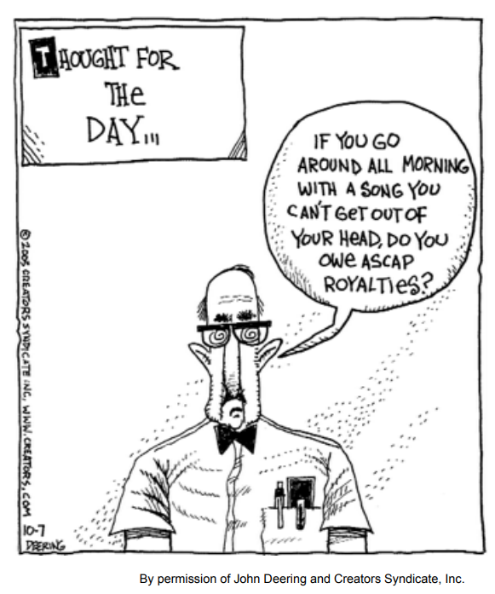

Slide 23
Key Court Cases and Legislation
Gershwin Publishing v. Columbia Artists
Basic Books v. Kinko’s Graphics
Davey Jones Locker
No Electronic Theft Act

Slide 24
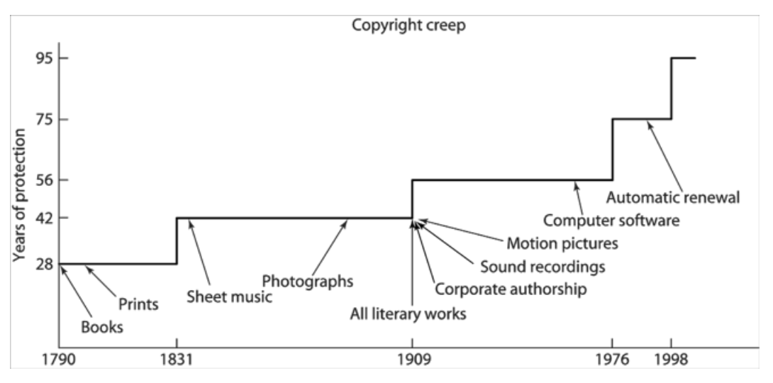
Copyright Creep

Slide 25
Copyright Creep
Since 1790, protection for books extended from 28 years to 95 years or more
Some say latest extension done to prevent Disney characters from becoming public domain
Group of petitioners challenged the Copyright Term Extension Act of 1998, arguing Congress exceeded Constitutional power
U.S. Supreme Court ruling
– CTEA does not create perpetual copyrights
– CTEA is constitutional

Slide 26
Fair Use

Slide 27
Fair Use Concept
Sometimes legal to reproduce a copyrighted work without permission
Courts consider four factors
– Purpose and character of use
– Nature of work
– Amount of work being copied
– Affect on market for work

Slide 28
Sony v. Universal City Studios
Sony introduced Betamax VCR (1975)
People started time shifting TV shows
Movie studios sued Sony for copyright infringements
U.S. Supreme Court ruled (5-4) that time shifting is fair use

Slide 29
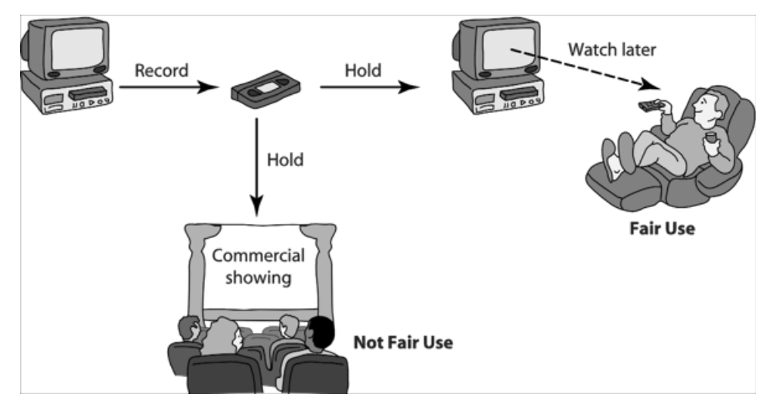
Time Shifting

Slide 30
Digital Recording Technology
Copying from vinyl records to cassette tapes introduced hiss and distortions
Introduction of compact disc a boon for music industry
– Cheaper to produce than vinyl records
– Higher quality
– Higher price ⇒ higher profits
BUT it’s possible to make a perfect copy of a CD

Slide 31
Audio Home Recording Act of 1992
Protects rights of consumers to make copies of analog or digital recordings for personal, noncommercial use
– Backup copy
– Give to family member
Digital audio recorders must incorporate Serial Copyright Management System (SCMS), so consumers can’t make a copy of a copy

Slide 32
RIAA v. Diamond Multimedia
MP3 compression allowed songs to be stored in 10% of the space, with little degradation
Diamond introduced Rio MP3 player (1998)
People started space shifting their music
RIAA started legal action against Diamond for violation of the Audio Home Recording Act
U.S. Court of Appeals, 9th Circuit, affirmed that space shifting is consistent with copyright law

Slide 33
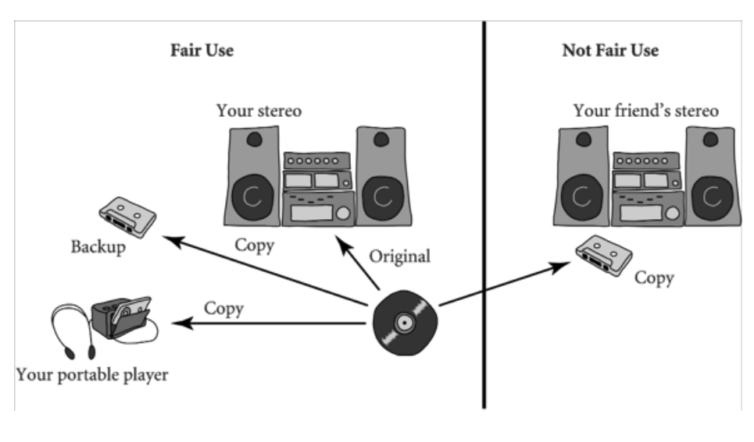
Space Shifting

Slide 34
Kelly v. Arriba Soft
Kelly: Photographer maintained Web site with copyrighted photos
Arriba Soft: Created search engine that returned thumbnail images
Kelly sued Arriba Soft for copyright infringement
U.S. Court of Appeals, 9th Circuit, affirmed that it was fair use

Slide 35
Google Books
Google announced plan to scan millions of books held by several huge libraries, creating searchable database of all words
If public domain book, system returns PDF
If under copyright, user can see a few sentences; system provides links to libraries and online booksellers
Authors Guild and publishers sued Google for copyright infringement (copying books for commercial reasons)
Out-of-court settlement reached

Slide 36
Benefits of Proposed Settlement
Google would pay $125 million to resolve legal claims of authors and publishers and establish Book Rights Registry
Readers would have much easier access to out-of-print books at U.S. public libraries and university libraries
University libraries could purchase subscriptions giving their students access to collections of some of world’s greatest libraries
Authors and publishers would receive payments earned from online access of their books, plus share of advertising revenues

Slide 37
Criticisms of Proposed Settlement
Google should have gone to court
– Google had a good case that its use was a fair use, based on precedent of Kelly v. Arriba Soft
– If Google had been found not guilty of copyright infringement, it could have given public access to books at lower rates
• Agreement gives Google a virtual monopoly over orphaned works
• Potential chilling effect of Google tracking the pages that people are viewing

Slide 38
Court Rejects Proposed Settlement
March 2011: U.S. District Court for Southern District of New York rejected proposed settlement
Judge ruled agreement would have:
– Given Google significant advantage over competitors
– Rewarded Google for “wholesale copying of copyrighted words without permission”
– Given Google liberal rights over orphaned works

Slide 39
End of Lecture

